Slide 1
Class 6: Summary Statistics Using Groupby and Apply
MGSC 310
Ben Labaschin

Slide 2
Class 6: Outline
Why Summary Statistics?
Complex Data: A Motivating Example
To The Code! Box and Whisker Plots, Groupby and Apply
Lab 6

Slide 3
Why Summary Statistics?
The typical summary statistics of a dataset: mean, median, mode, quartiles, ranges, number of missing values, count of rows and columns
But why do we care about summary statistics?
Often our data is too numerous, sparse, or complex to describe usefully, to understand, or even to model! This is when we resort to summary statistics.

Slide 4
Complex Data: A Motivating Example (1 of 4)
Time Series Data is a perfect example of raw data that is difficult to encapsulate.
Raw data refers to unprocessed, unfiltered information collected directly from a source, without any transformation.

Slide 5
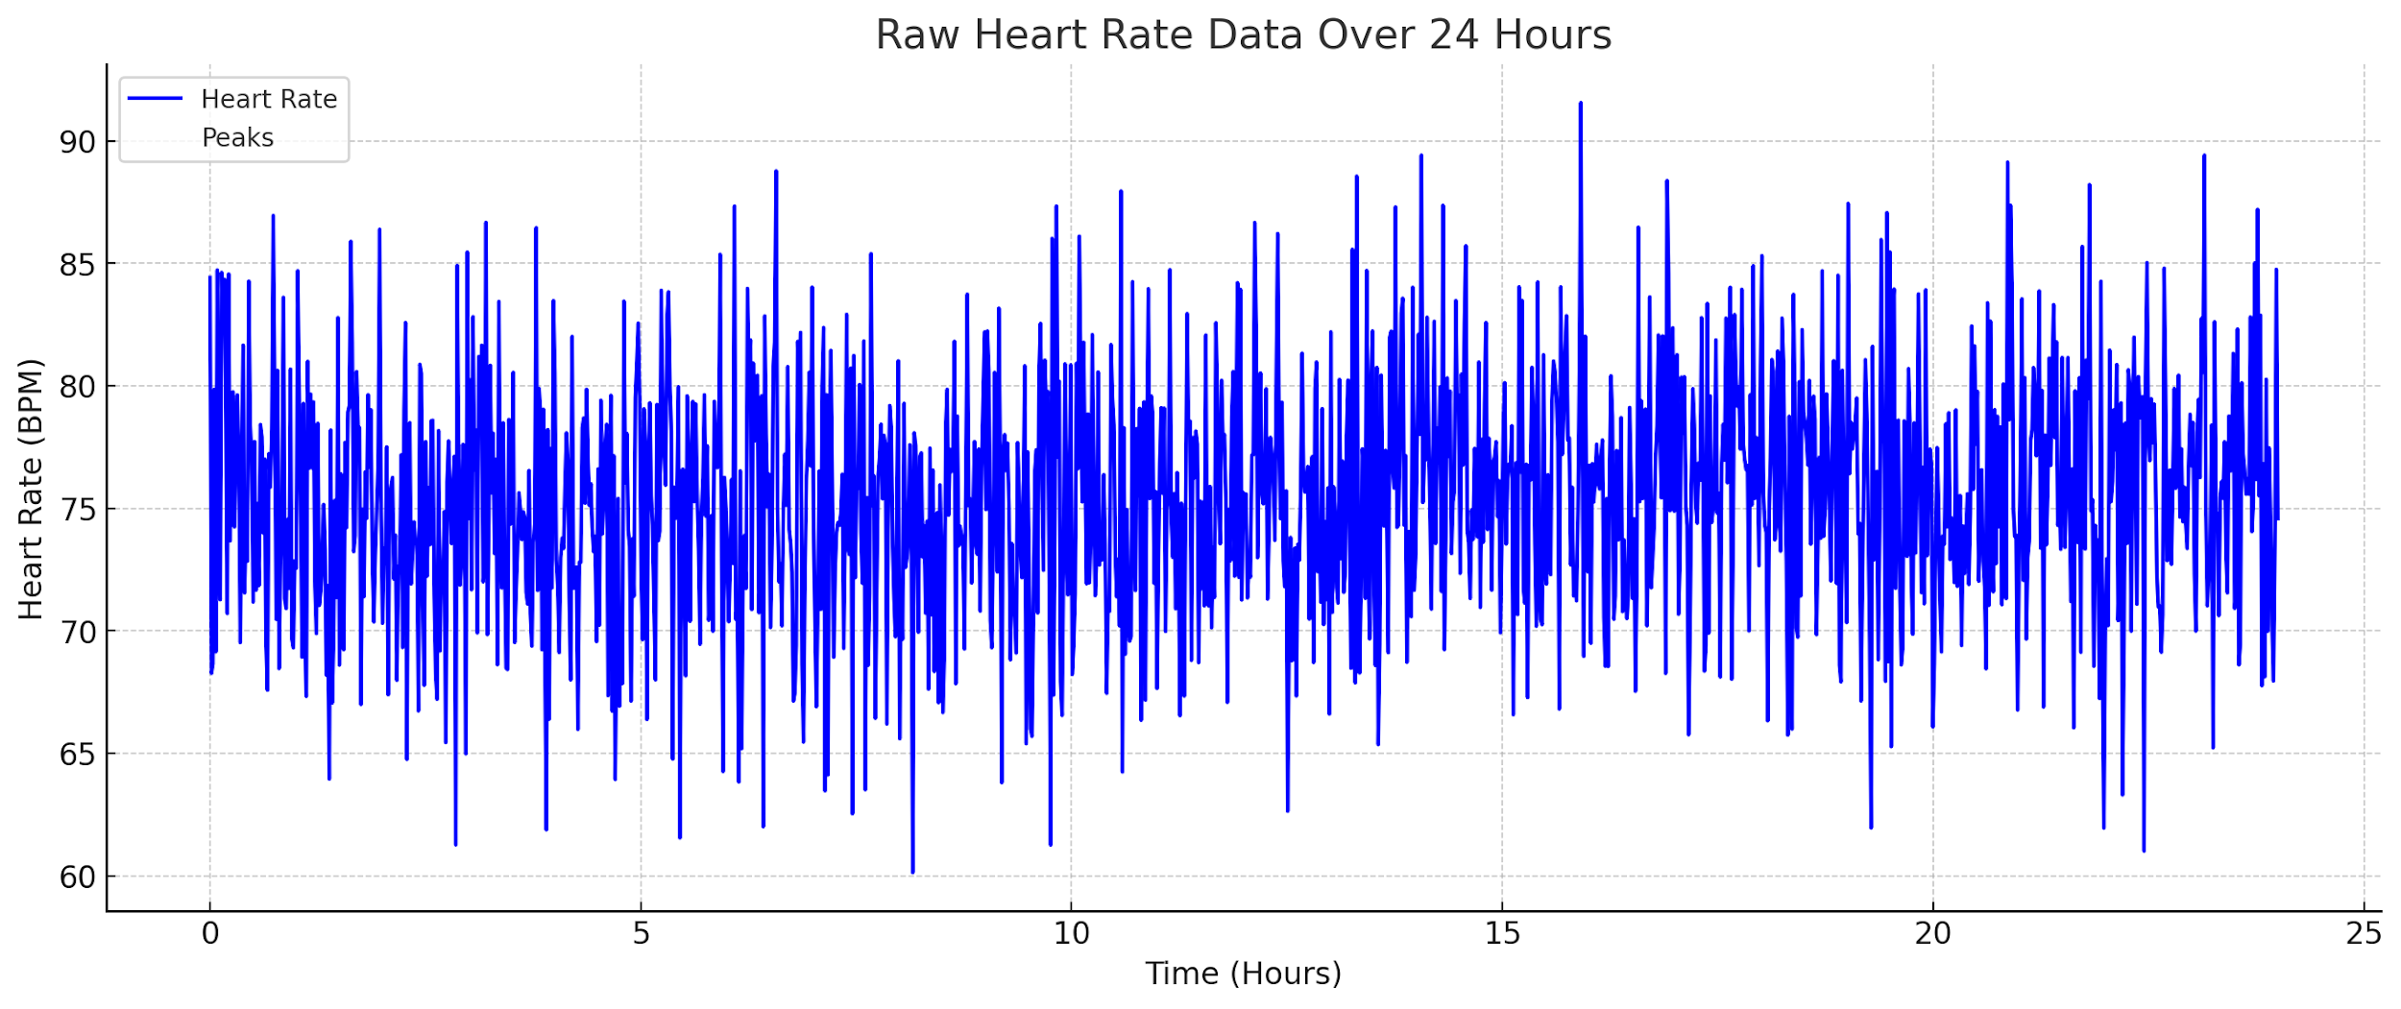
Complex Data: A Motivating Example (2 of 4)
Scenario: Consider a hypothetical situation where we have the heart rate data of a patient monitored over 24 hours.

Slide 6
Complex Data: A Motivating Example (3 of 4)
Heart rate data can be noisy: random variations can obscure underlying patterns or trends.
By using summary statistics and time series decomposition, we can isolate trends and patterns that are more informative for medical professionals.

Slide 7
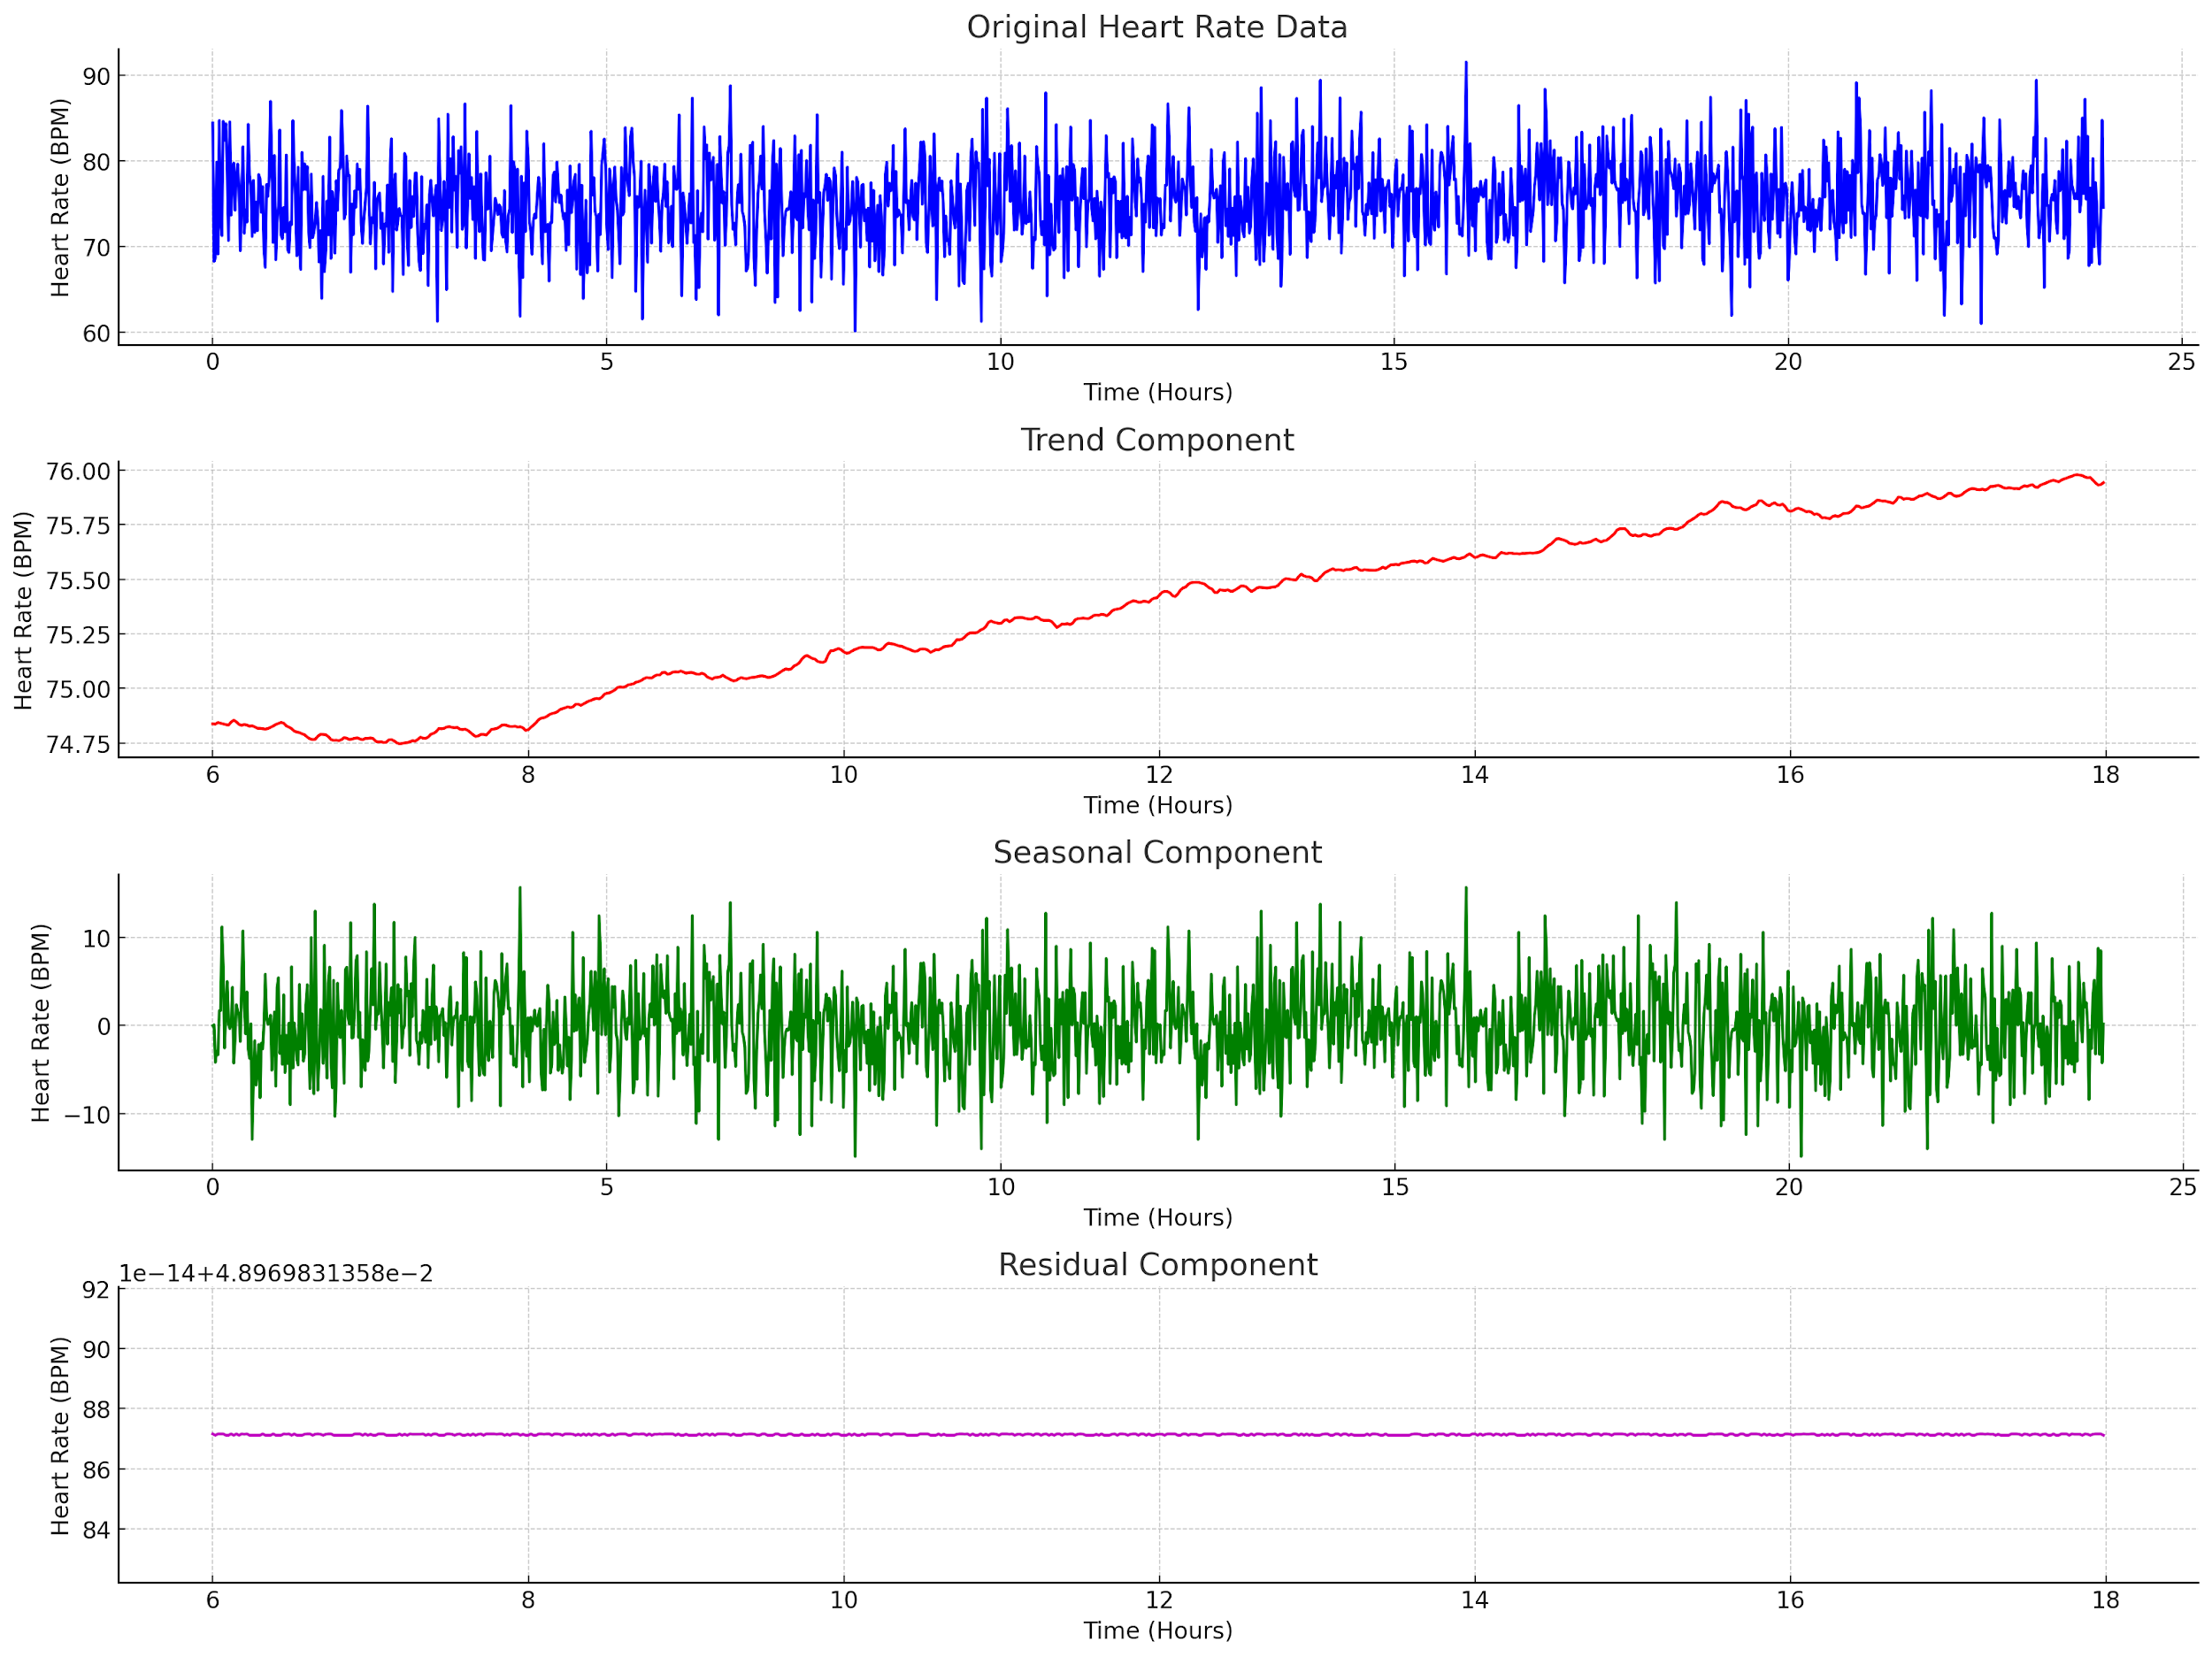
Notes:
Original Heart Rate Data: This is the raw, noisy data that we started with. It's difficult to interpret directly.
Trend Component: This shows the underlying trend in the heart rate data. We can see that the heart rate seems relatively stable, with minor fluctuations.
Seasonal Component: This captures the periodic fluctuations in the data. In real-world scenarios, this could be due to daily activities, meals, or sleep cycles.
Residual Component: This is the noise left over after removing the trend and seasonal components. It captures random fluctuations and errors.

Slide 8
Complex Data: A Motivating Example (4 of 4)
Instead of dealing with the complexity of the raw data, healthcare professionals can focus on these simpler components and summary statistics to assess the patient's condition.
For instance, if the trend shows a continuous increase, it may be a cause for concern. Similarly, unusual patterns in the seasonal or residual components could indicate anomalies worth investigating.

Slide 9
To The Code! Box and Whisker Plots, Groupby and Apply
To the code!

Slide 10
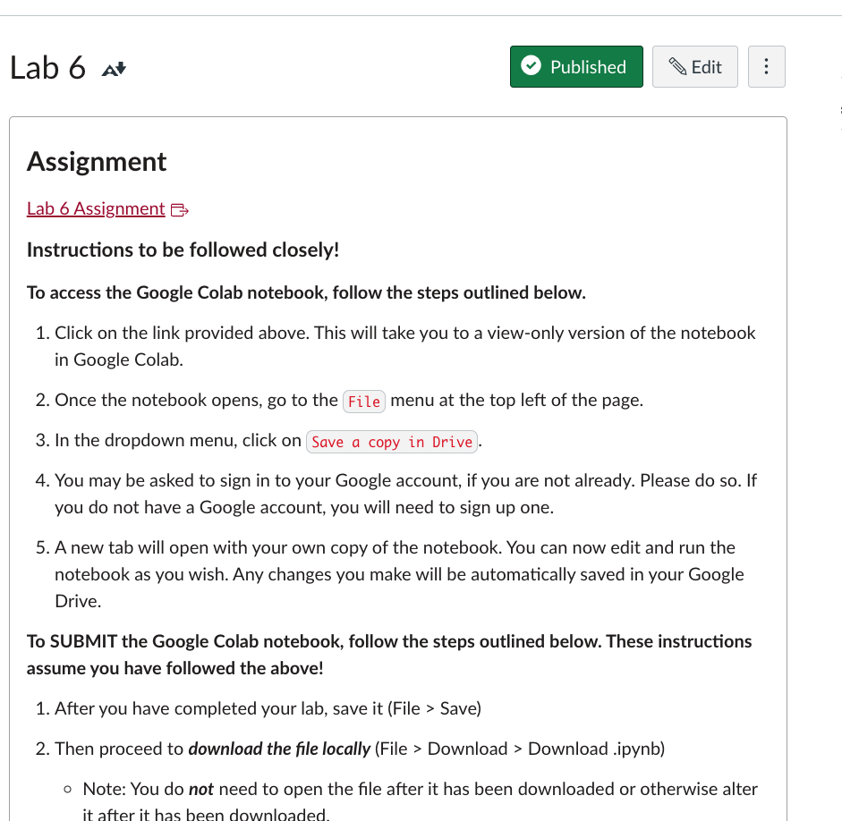
Lab 6

